Slide 1

Escaping from Apocalypse-Conductivity of Strong and Weak Acids and Bases

Slide 2
Safety Protocols
Lab coat
Googles
Long sleeves
Long pants
Closed-toe shoes

Slide 3
Observation
Substance Tested | LED Brightness | Conductivity
Deionized Water
Tap Water
HCl(aq)
acetic acid (aq)
NaOH(aq)
Ammonia(aq)
LED Brightness: off, dim, medium, bright, very bright
Conductivity: none, low, medium, high, very high

Slide 4
How do we know whether a solution is conductive from this demo?
The light is on when immersing the light conductivity tester in the solution

Slide 5
What makes the light turn on?
The presence of ions. Ions are conductive and molecules are not conductive in general

Slide 6
Demo Time

Slide 7
Discussion question: Assuming you have unlimited supply of the above chemicals, which solution(s) would you choose to help you get out of the lab safely?

Slide 8

What is the difference between strong acids and bases based on these chemical equations?
HCl(aq) + H₂O(l) → H₃O⁺(aq) + Cl⁻(aq)
CH₃COOH (aq) + H₂O(l) ⇌ H₃O⁺(aq) + CH₃COO⁻ (aq)
NaOH(aq) → OH⁻ (aq)+ Na⁺(aq)
NH₃(aq) + H₂O(l) ⇌ NH₄⁺(aq) + OH⁻(aq)
Strong acids and bases dissociate almost completely in water.
Weak acids and bases do not dissociate completely.
Notes:
the chemical equation direction of the reaction progression sign; what does one arrow mean? How about two arrows?

Slide 9
How is the strength of acids and bases related to conductivity?

Slide 10
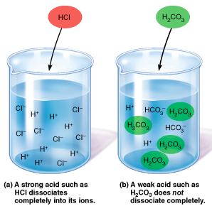
Microscopic views-Strong and Weak Acids
Strong acid (almost 100% dissociation)
Ions dominant (H⁺ & Cl⁻)
Weak acid (on average 1% dissociation)
Molecules dominant (e.g. H₂CO₃)
Strong acids more conductive than weak acids

Slide 11
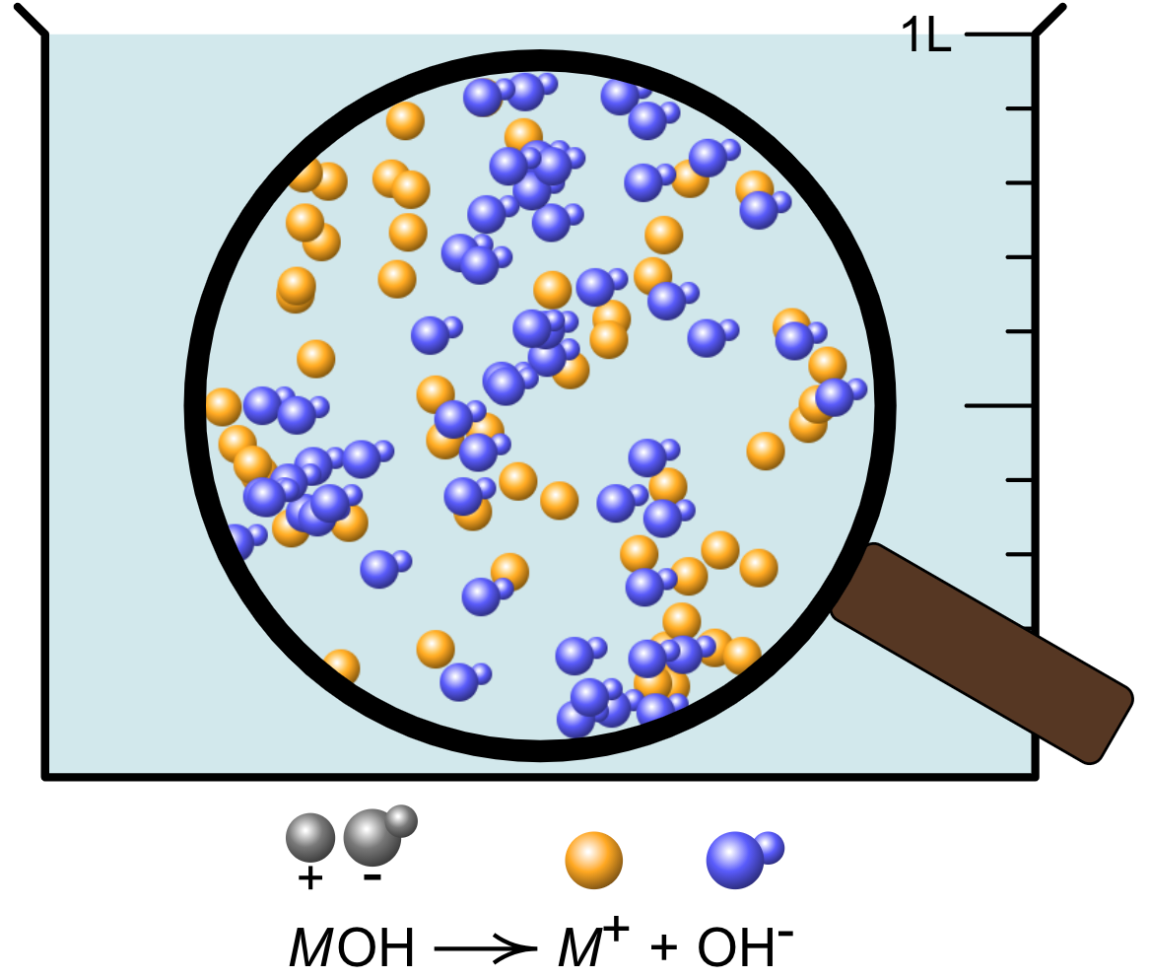
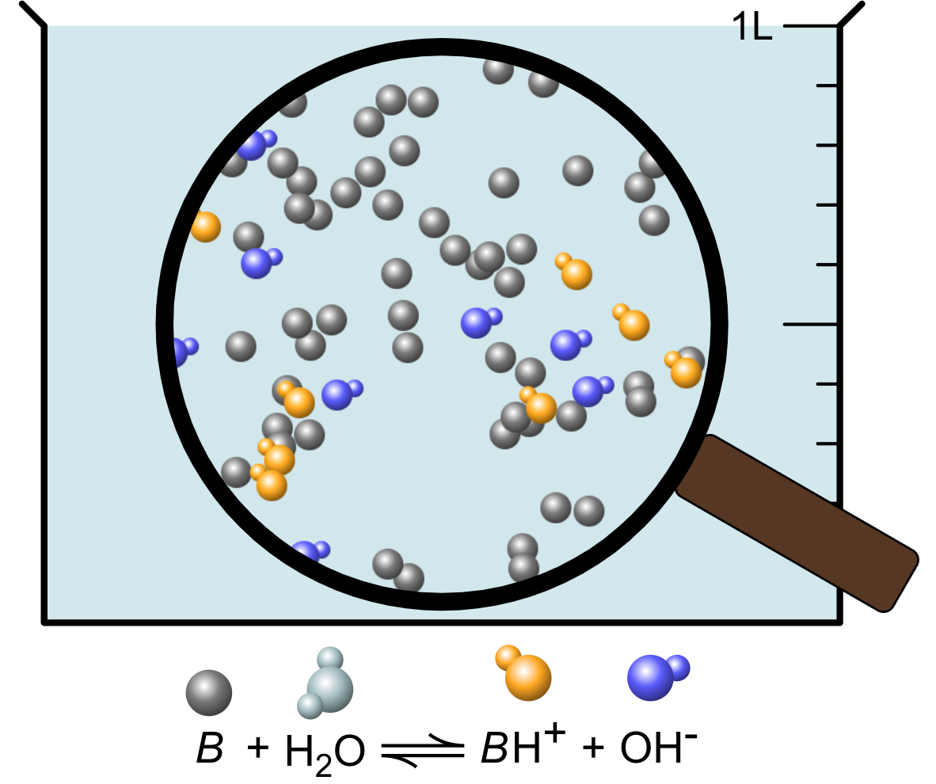
Microscopic views-Strong and Weak Bases
Strong base (100% dissociation)
Strong base (1% dissociation)
Ions dominant (Na⁺ & OH⁻)
Molecules dominant (e.g. NH₃)
Strong bases more conductive than weak bases

Slide 12
What are the two major limitations of using strong acid/base as conducting materials?

Slide 13
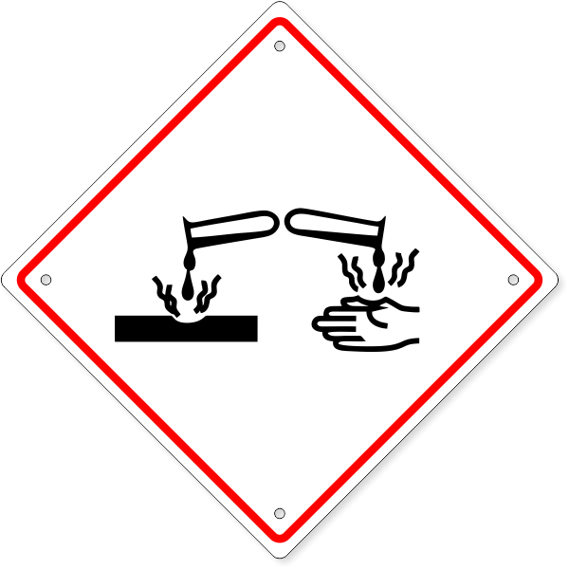
Limitations of Choosing Strong acids & Bases
Strong acids and bases are often corrosive to skin and metal. If not handled properly, they can be dangerous

Slide 14
Can you think of other solutions in your daily life that you can use as conducting materials?

Slide 15
Conductive Chemicals in Your Daily Life
Salt water
electrolyte drinks

Slide 16
Quantitative Measure of the strengths of Acids and Bases in Solutions
Acids: Acid dissociation constant (K_{a})
Bases: Base dissociation constant (K_{b})

